Slide 1
You Can Make a Difference!
Lynda Ender

Slide 2
Defining Advocacy
Individual Advocacy:
Pleading the cause of another
Legislative Advocacy:
Defending a cause or proposal
Grassroots Advocacy:
Appealing to officials through the general public

Slide 3
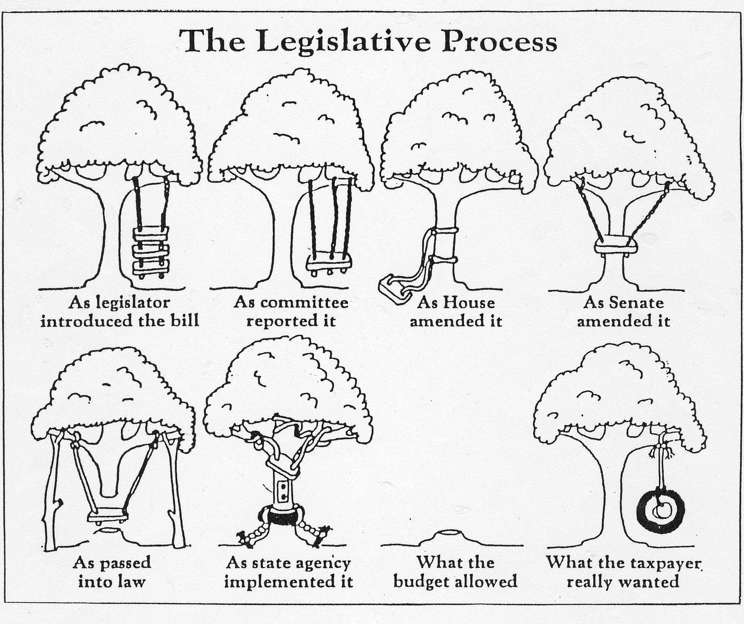

Slide 4
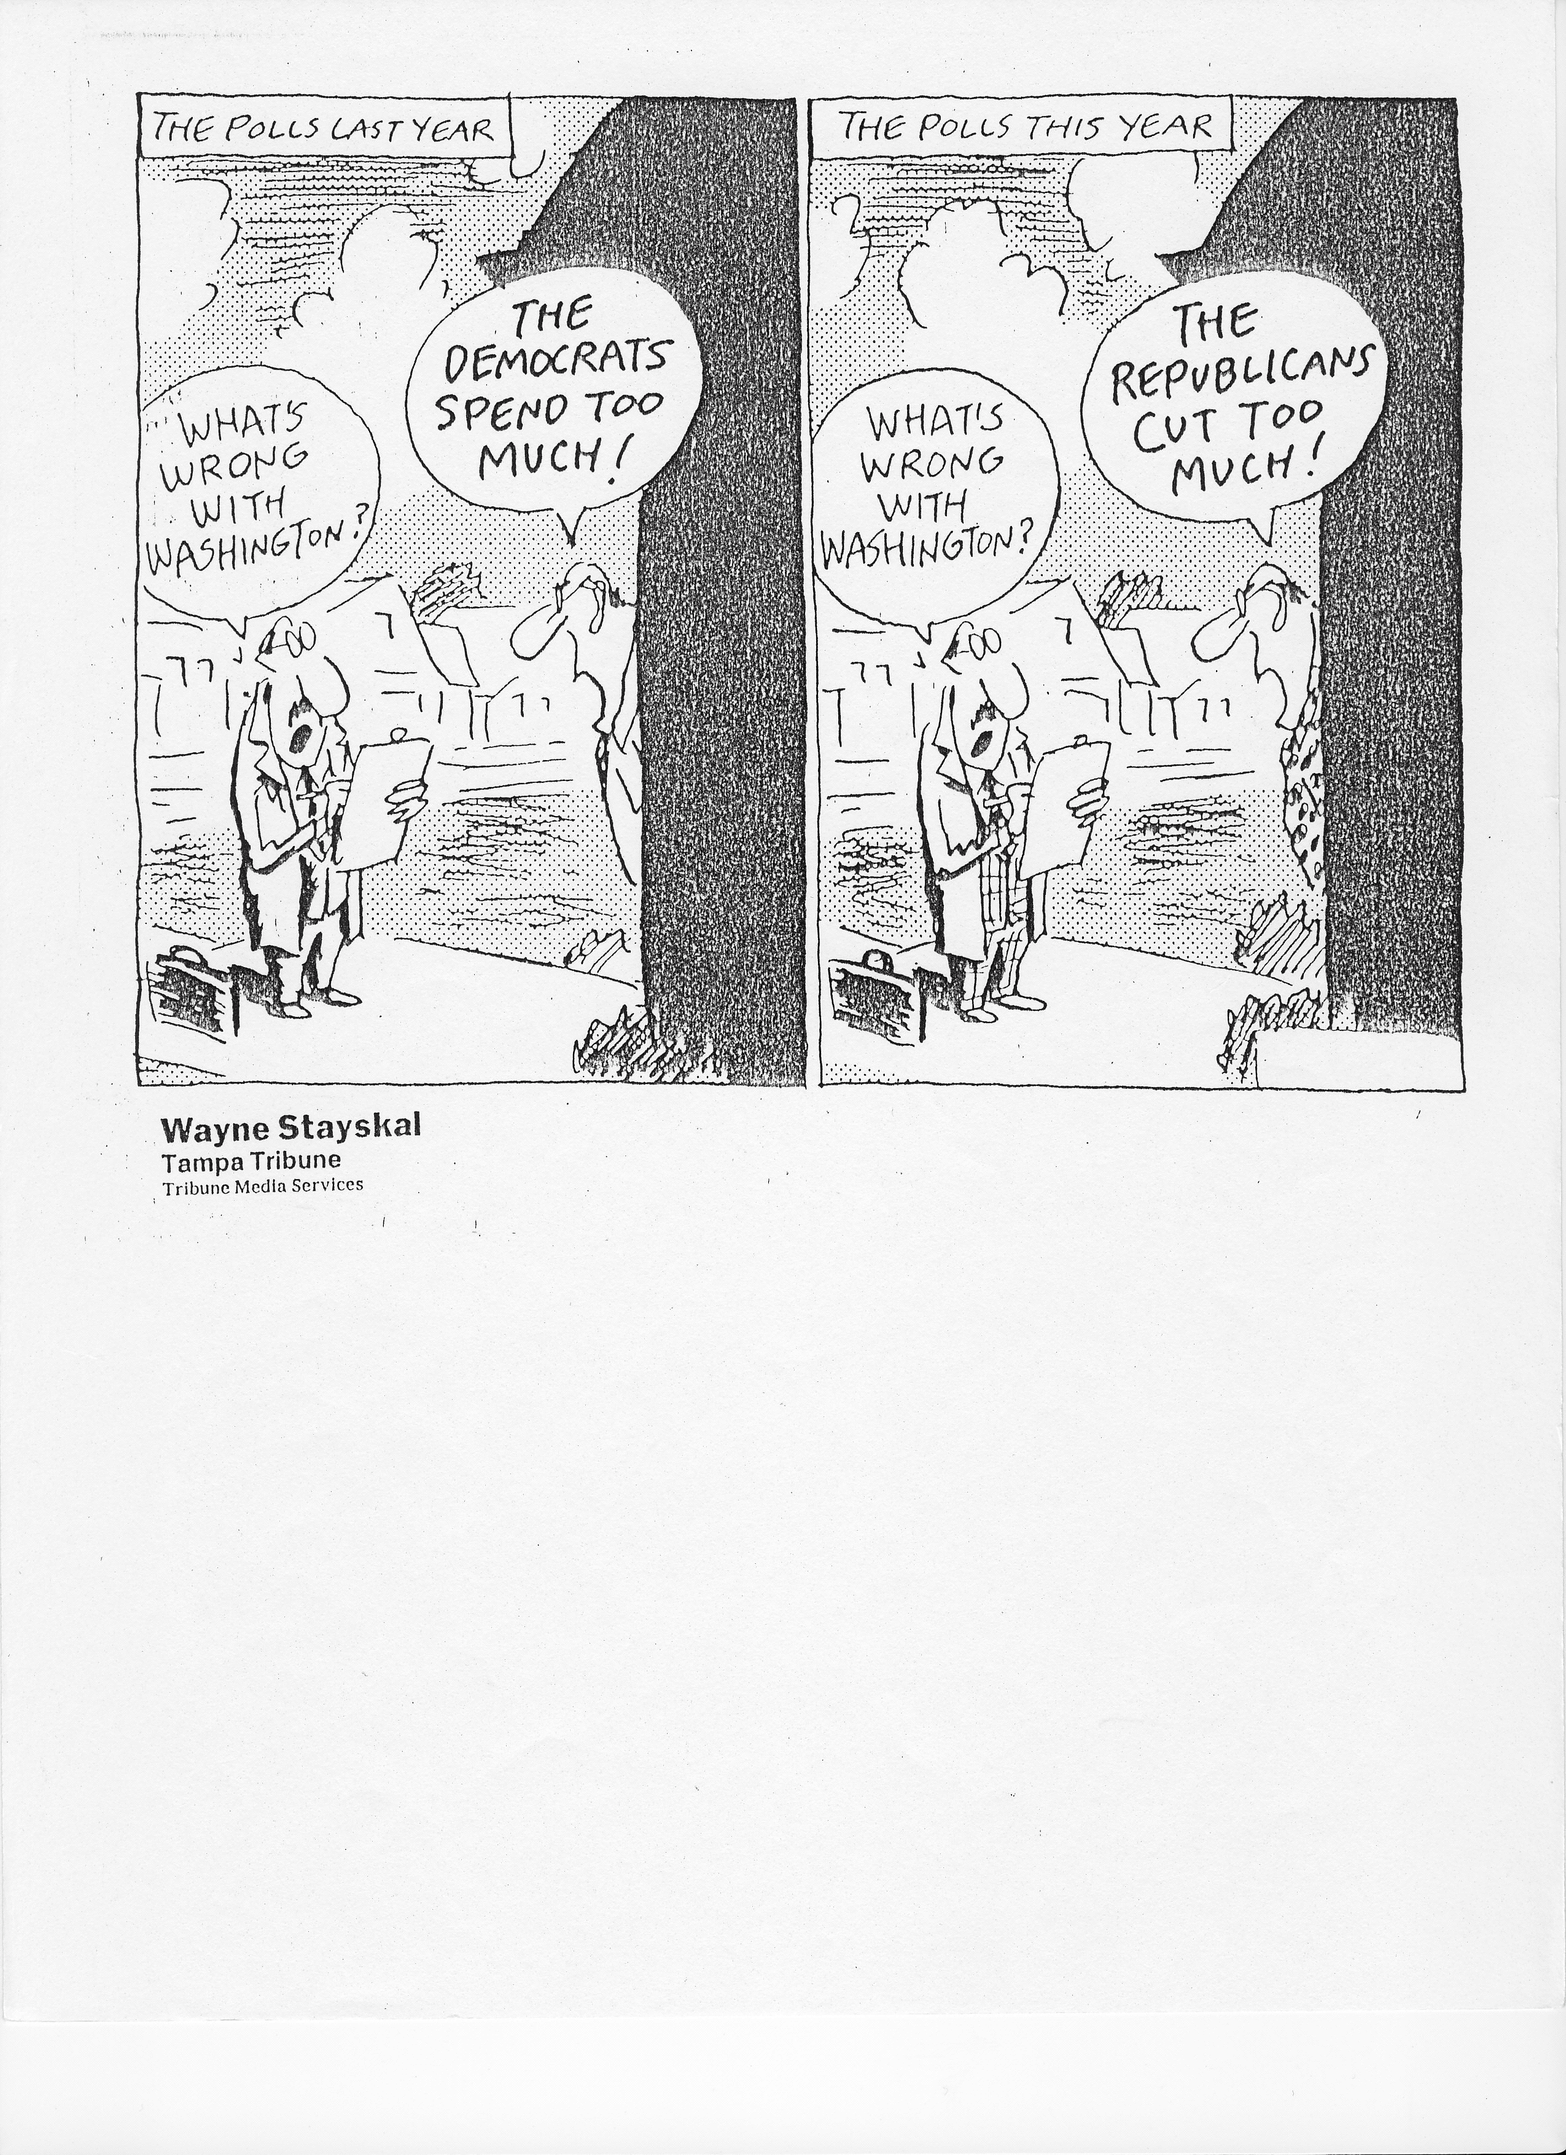
Legislative Process
Notes:
Many different opinions
Elected officials reflect the views of their constituents.
Gib Lewis story – big hair, plaid suits, folksy sayings, bolo ties

Slide 5
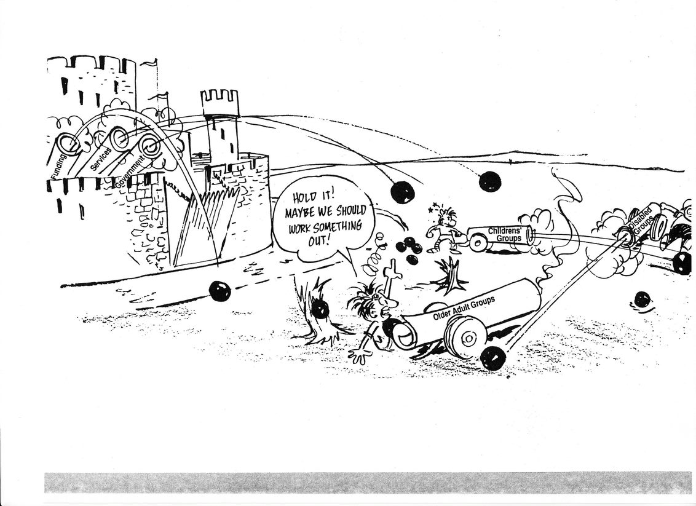
Working with Coalitions
Notes:
Communication is key
Keep everyone in the loop
Every group meets with elected officials

Slide 6
The Legislative Process

Slide 7
Bill Tracking
Texas Toll Free #:
1-877-824-7038
Texas Internet:
www.capitol.state.tx.us
U.S. Government Internet:
www.thomas.loc
U.S. Senate:
www.senate.gov/
U.S. House of Representatives:
www.house.gov/

Slide 8
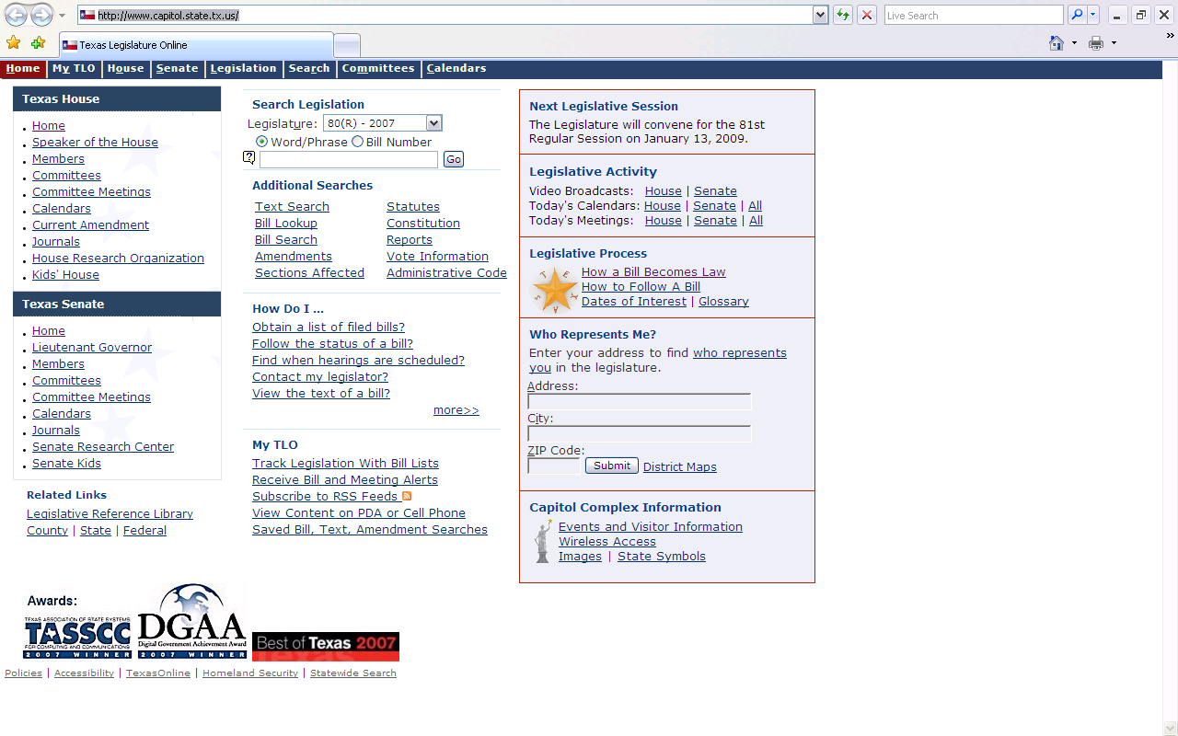
www.capitol.state.tx.us

Slide 9
Rules for Success
Understand the Legislative Process
Realize that most Legislators do not know our people or our issues.
Develop a powerful personal story.
Present your personal story at meaningful times to educate and influence your own Legislators.
Know how to win – and lose – with grace.
Know how to be generous in your thanks and praise.

Slide 10
A Success Story

Slide 11
Create a Public Policy Agenda
& Plan for Action
Issue
Objective
Position
Research
Strategy
Staff, committee, coalitions, organizations & board roles
Personal stories

Slide 12
Write & Call
Purpose: To ensure constituent contacts and education of policy-makers.
Tips
Handwritten notes have the biggest impact
Be brief
Stick to one issue
Be specific in what you ask for
Make sure that you include your name and address, so there will be a record of your contact
When calling, do not expect to speak to the policy-maker and ask for the staff that works on your specific issue if the official is not available
Thank them for listening

Slide 13
Town Meetings
Purpose- To solicit community input to educate policy-makers.
Tips
Use an accessible location
Invite all interested parties/confirm attendance
Cover a single issue or multiple issues
Set ground rules for giving input
Publicize the event
Have the right people hear the input
Have a neutral facilitator moderate the meeting
Identify solutions and “next steps” with the audience/community
Get media coverage

Slide 14
Testimony
Purpose- To publicly address policy-makers in a formal setting.
Tips
Address only one issue at a time
Sign up in the official record
Bring written copies for policy-makers, staff and press
Keep testimony to 3-5 minutes
Tell the policy-makers specifically what you want them to do
Thank them for their time
Follow-up—thank you note, send written copy, office visit

Slide 15
Rally/Press Conference
Purpose- To focus policy-maker & community attention on a critical issue or need.
Tips
Identify a single paramount issue
Develop a catchy slogan or “gimmick”
Solicit/entice media support
Invite policy maker to join presenting team
“Turn out the troops”
Propose an achievable solution
Follow-up—as appropriate

Slide 16
Organize an Alert Team
Purpose- To ensure constituent contacts with the policy-makers at critical points in the decision-making process.
Tips
Organize “Telephone Tree” of committed constituents and/or an e-mail distribution list
Train members on the Do’s and Don’ts of phone calling and on key issues
Connect with local advocacy organization and/or professional association alert systems
Respond when alerted by “activating” telephone tree and e-mail list
Follow-up—let members know outcome of calls/e-mails

Slide 17
Office Visits
Purpose- To help the policy-maker get to know your agency and your clients.
Tips
Schedule well in advance
Put together a team: Consumers, family members, experts
Develop a theme and use it throughout the meeting
Concentrate on personal stories
Role-play through a dress rehearsal
Leave behind basic information
Follow-up: thank you note, send more written information if requested

Slide 18
Program Visits
Purpose- To help the policy-maker get to know your agency and the services you provide.
Tips
Schedule well ahead of time
Organize a hosting committee
Visit model programs
Make sure to visit locations or programs when consumers are there
Have an “expert” available at each site to answer questions
Visit not more than 3 sites
Promote media coverage
Follow-up—thank you note, send additional information if requested

Slide 19
When Talking to Your Legislator…
Do:
Don’t
Make sure your Legislator knows you
Work with the Legislator’s staff
Be prepared
Discuss one issue at a time - be brief but thorough
Leave simple written materials that has your name and contact information included
Show your Legislator how your position will help their district
Establish an on-going relationship and a reputation for reliability
Try to talk to a Legislator when they are obviously in a hurry
Overload them with written material
Assume they are familiar with the issue
Talk about too many issues at once
Use jargon or acronyms
Have two or three attendees, but don’t bring a crowd

Slide 20
Visiting Your Legislator
Demonstration

Slide 21
Why It’s Important For You To Get Involved
Your personal story/experience puts a face on the issue.
Complex, dry, technical or bureaucratic information becomes understandable, memorable and compelling.
Legislators will have specific examples that allow them to advocate for your issues.
If you don’t, nobody will.
It really can make a difference.

Slide 22
Thank You
Democracy Is Not a Spectator Sport!
Lynda Ender
AGE Director
The Senior Source
lender@theseniorsource.org
214-525-6113

